Slide 1

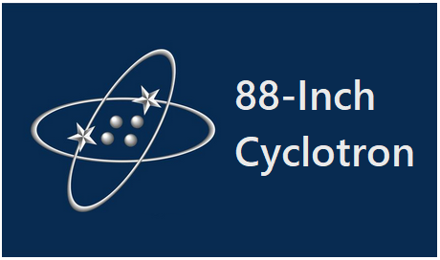
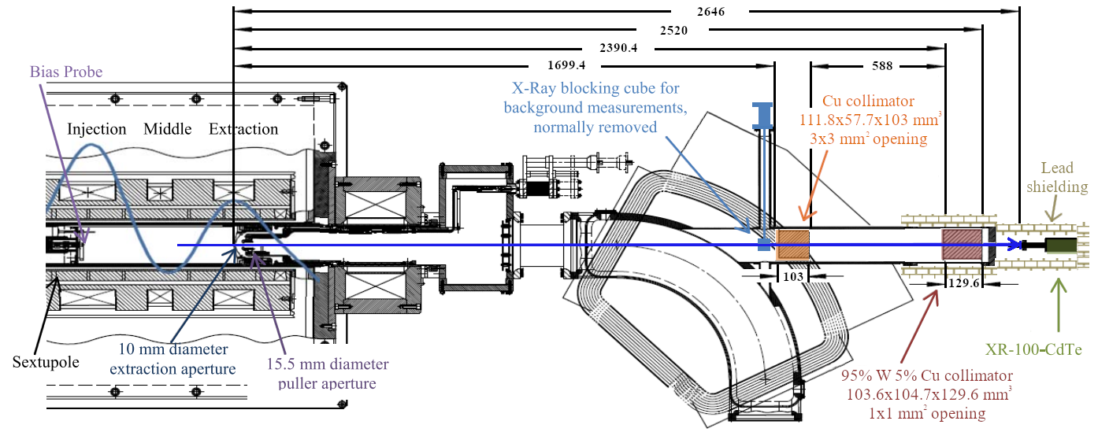
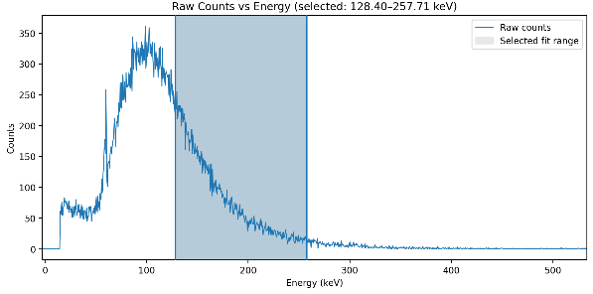

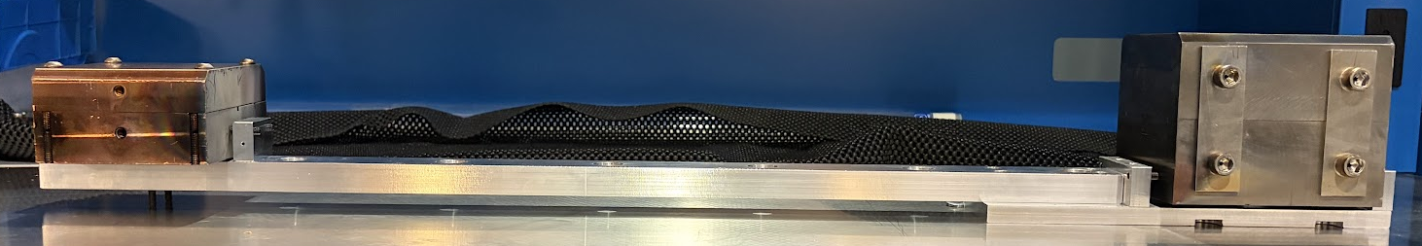
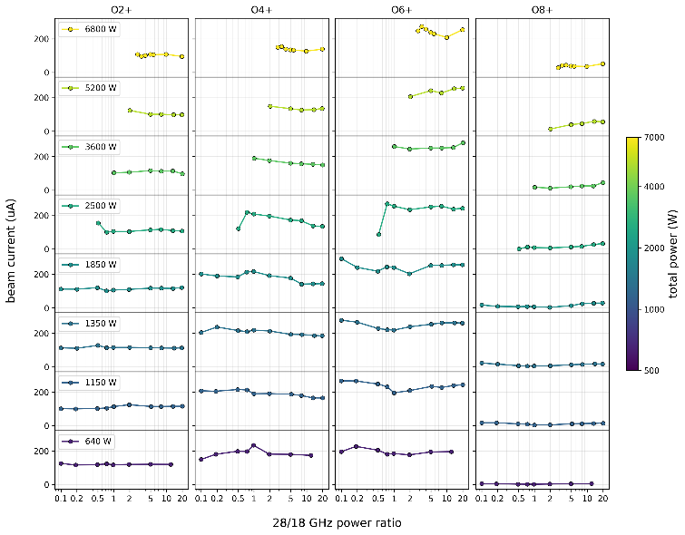
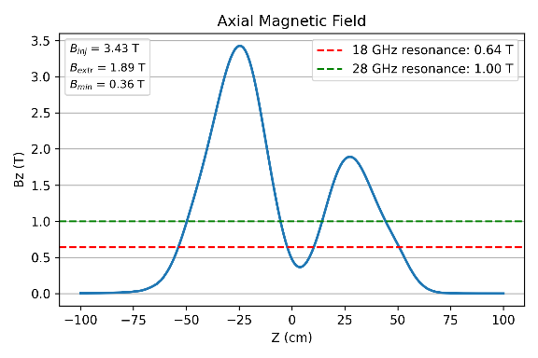
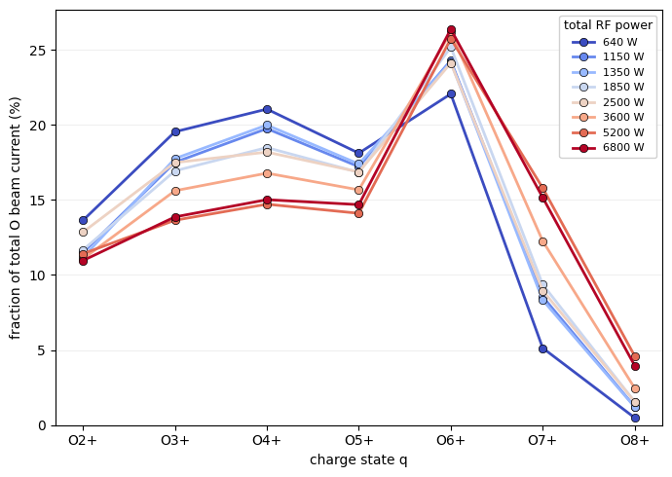
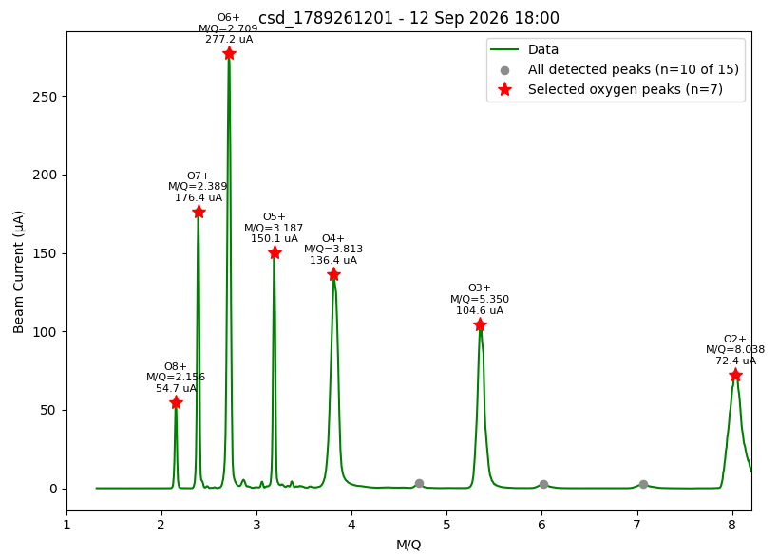
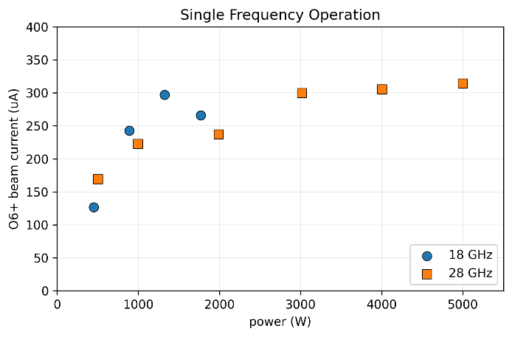
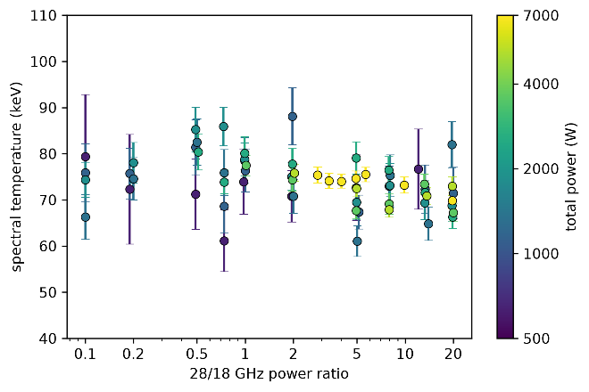
Two-Frequency Heating Phenomena at the Superconducting VENUS ECR Ion Source
Lawrence Berkeley National Laboratory
N. Intwala, J. Benitez, M. Chen, B. Peri, J. Rehak, T. Thuillier, D. Todd
Introduction
Experimental Setup
Two-frequency heating of ECR ion sources has been shown to produce 2-5 times more high-charge state ions versus single frequency heating, while also enhancing plasma stability and shifting the charge state distribution to higher charge state ions [2].
In this experiment, we explore the effects of 18 and 28 GHz heating on the charge state distributions.
Figure 1: Schematic of the XR-100-CdTe detector at the VENUS ion source.
Methodology
Axial x-rays emitted from the plasma travel through the 10 mm diameter extraction aperture and two collimators to be measured by the XR-100T CdTe detector (Figure 1) and AMPTEK ADMCA software. A custom alignment fixture (Figure 2) was built to secure the two collimators in place relative to each other while allowing for fine tuning horizontally, vertically, along the x-ray path, and rotationally.
The beamline and fixture were 3D modeled in Creo Parametric and then designed such that the centerline of the collimator apertures lie exactly centered in the horizontal and vertical midplane of the beampipe. Add screenshot of CREO?
Their alignment was tested with a laser held approximately 2.5 m upstream of the Cu collimator to simulate x-rays coming from VENUS’ extraction. The spacing between the collimators was calculated such that the field of view of the x-ray detector is an 8.4 mm square, which ensures that only x-rays emitted directly from the plasma are seen (less than 10 mm extraction diameter). So that anything outside the 10 mm extraction diameter is blocked by the collimators.
For every run, VENUS was tuned primarily with the bias disk and injection pressure to optimize stability and production of O6+ on the faraday cup after the analyzing magnet (BATMAN). The magnetic fields were held constant as shown in Figure 2 for the entire data collection (Figure 3).
Figure 3: Axial magnetic field.
X-ray data were collected for 10 minutes at each power level (a combination of either 18 GHz klystron, 28 GHz gyrotron, or both) at various total power levels, and then a charge-state distribution (CSD) was taken (Figure 4).
Figure 4: Sample CSD (from when), add details
X-ray data was analyzed to find the spectral temperature (Figure 5) by taking the negative slope of the log of the normalized and detector-efficiency-corrected data (in the linear region). The steeper this slope is, the higher the hotter the electrons in the plasma are, which leads to a greater heat load on the superconducting magnet cryostat.
Formula for spectral temperature
Formula for beam current as function of frequency^2
Figure 2: An adjustable alignment arm, used to align and fix both collimators in place with the center of the beamline.
Two-Frequency Power Results
Figure 5: finding spectral temperature from x-ray spectrum. Under what conditions
Figure 6: Beam currents of oxygen charge states vs 28 GHz to 18 GHz power ratio.
Conclusion
At a fixed magnetic field configuration, the oxygen beam currents do not depend on the ratio of 28 to 18 GHz power. Rather, the charge state distribution shifts to favor higher charge states with higher total power.
The beam current is expected to increase as the square of the frequency, which does occur with single frequency heating (Figure 8). With two frequencies, however, this effect is negated.
Future Work
Figure 7: The oxygen charge state distribution shifts to higher charge state with more total power.
Repeat data collection with different axial magnetic field configurations
Repeat measurements with addition of 14 GHz source (14, 18, and 28 GHz)
Repeat measurements with two 18 GHz klystrons and one 28 GHz gyrotron
Repeat measurements with AECR (14 GHz klystron and 11-13 GHz variable TWT)
Develop a machine learning framework to predict behavior at higher total powers/higher frequencies
Comparison to Previous Work
References
[1] Lyneis, Xie, 1995 12th International Workshop on ECR Ion Sources
[2] R Geller (should be first)
[4] Kitagawa, Racz, Kato, Takasugi
[5] Benitez (only depends on Bmin)
[9] J Benitez, C Lyneis, L Phair, D Todd and D Xie 2017 IEEE Transactions on Plasma Science 45 7
Figure 8: Single frequency heating agrees with previous measurements [4]. Beam current increases with total power.
Figure 9: Spectral temperature agrees with previous measurements [5]. Does not change with different power or frequencies.

